Slide 1


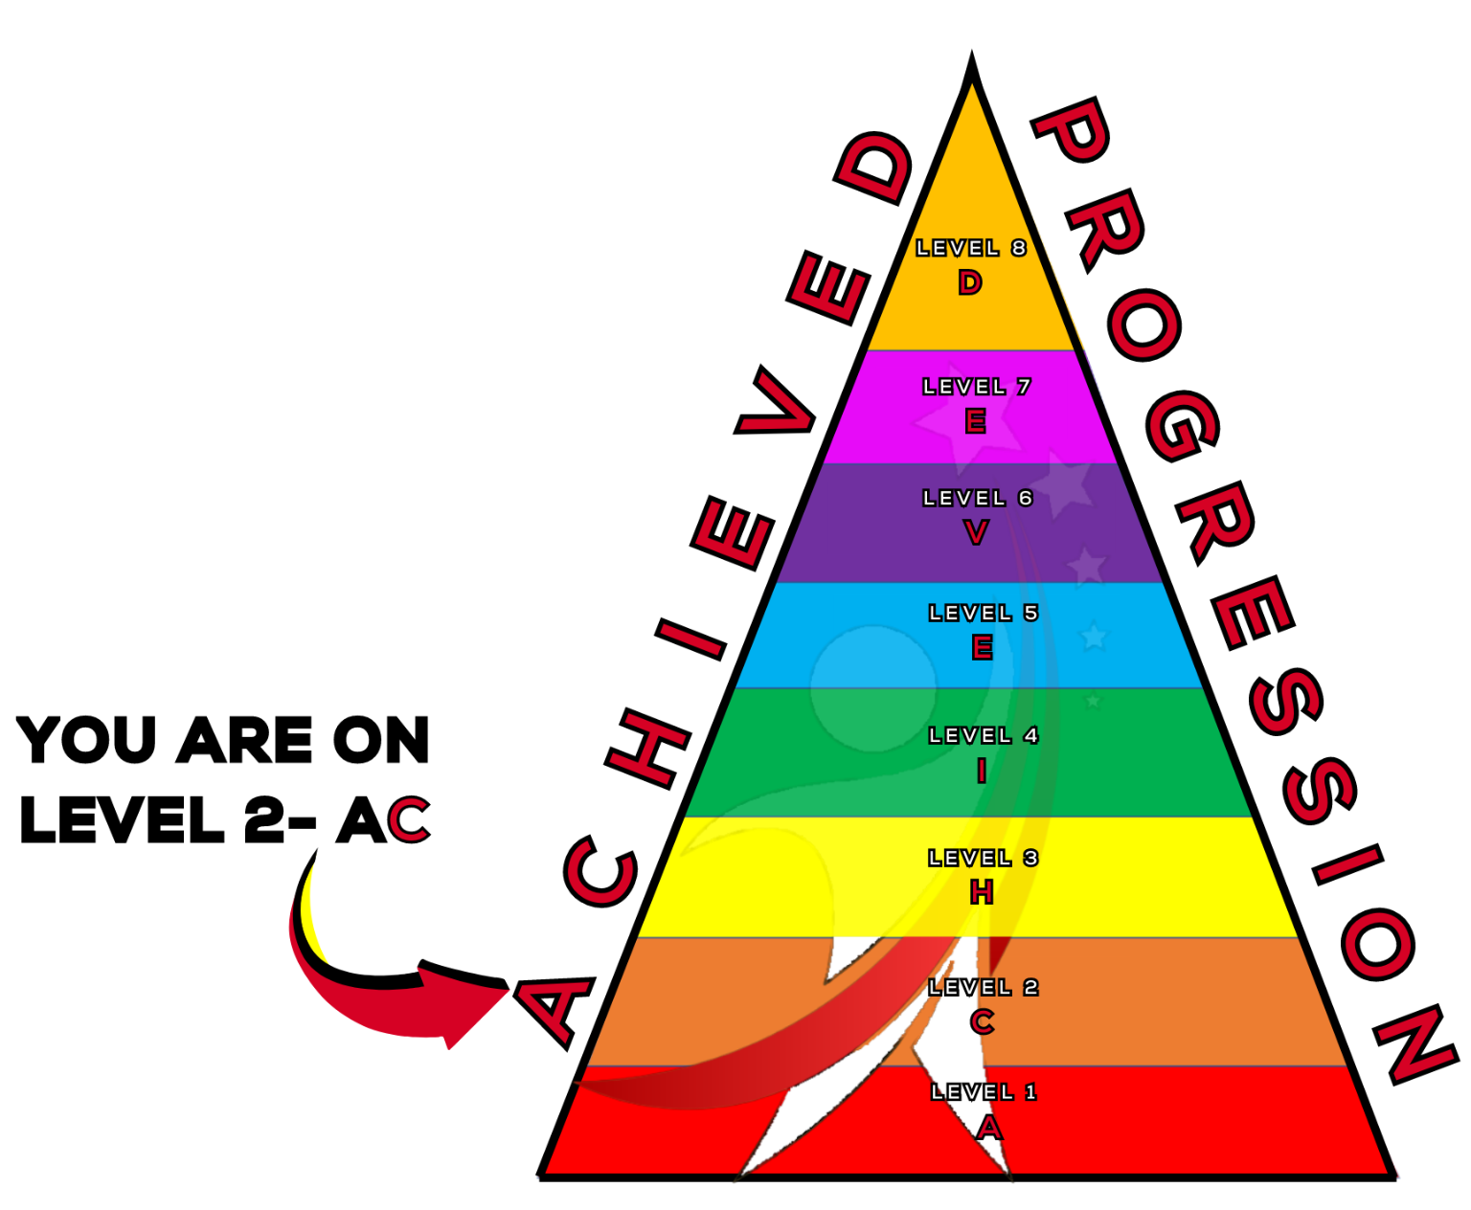
Understanding Notation
A topic from Thespian Progression Level 2 - C

Slide 2
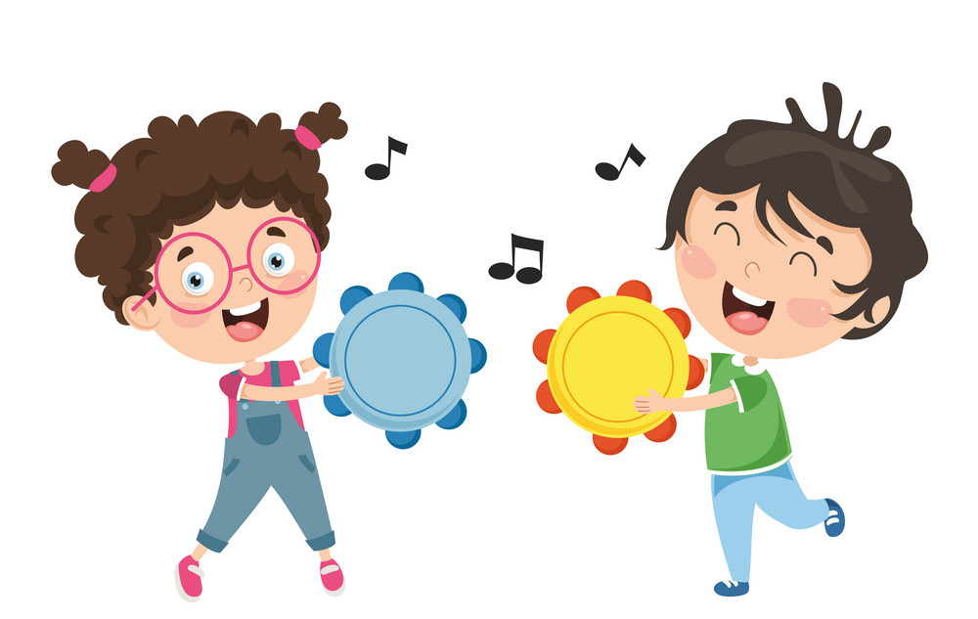

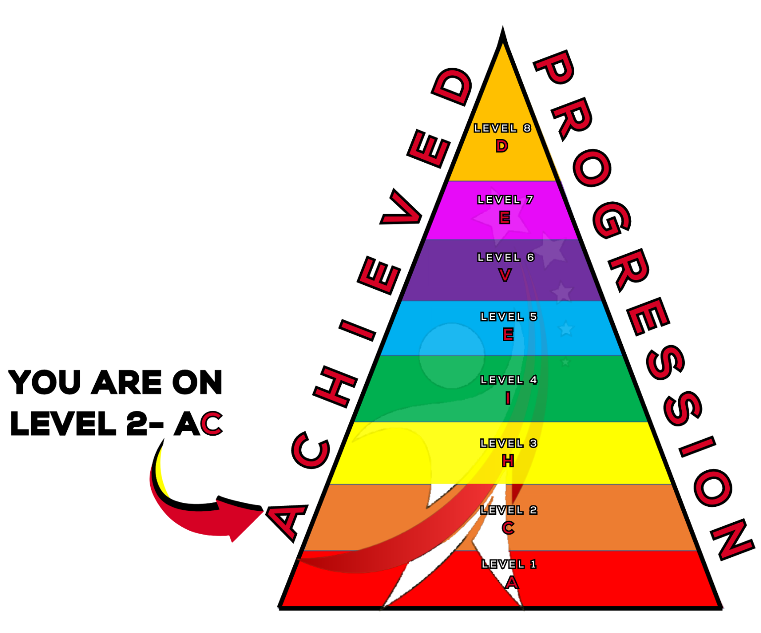

What will we learn today?
We will develop our understanding of notation
We will apply the notes and values we have learned to create different rhythms.
ACHIEVED

Slide 3




As a reminder…
Quaver
½ beat
Crotchet
1 beat
Minim
2 beats
Semibreve
4 beats
Longer in duration
ACHIEVED
Notes:
A quaver (like the crisp) last for half a beat.
A crotchet lasts for 1 beat.
A minim lasts for 2 beats.
A semibreve lasts for 4 beats.
Each note DOUBLES in value.
you can fit 2 quavers in 1 crotchet. 2 crotchets in 1 minim. 2 minims in 1 semibreve.

Slide 4
Answer these Music Maths Questions
+
=
-
=
+
=
+
x
=
1)
2)
3)
ACHIEVED

Slide 5
Now it’s your turn!
Let’s make an
easy, medium and hard
Music Maths Question!
Use post-it notes to write down your equations!
Make sure to work out the answers!

Slide 6
Clap along to the rhythm!
1
2
3
4
1
&
2
3
&
4
Count out loud as you clap along!
Does this one sound familiar?
Can anyone guess the song?
ACHIEVED

Slide 7
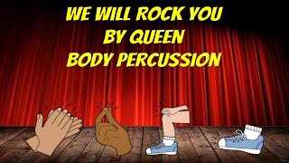
We Will Rock You- Queen
ACHIEVED

Slide 8
Did you notice?
We played two different rhythms during that song. The first pattern was a rhythm. The second pattern was a pulse.
What is the difference between pulse and rhythm?
A pulse is a beat that is regular. A rhythm is a pattern of sounds of different lengths!
ACHIEVED

Slide 9
Rhythm and Pulse
1
2
3
4
1
&
2
3
&
4
This is a Pulse.
This is a Rhythm.
ACHIEVED

Slide 10
Final Task
Let’s have a go at creating some different rhythms.
In your pairs, you will need to create a 2 part rhythm, one person will clap and the other wil stomp their feet!
For example:
ACHIEVED

Slide 11
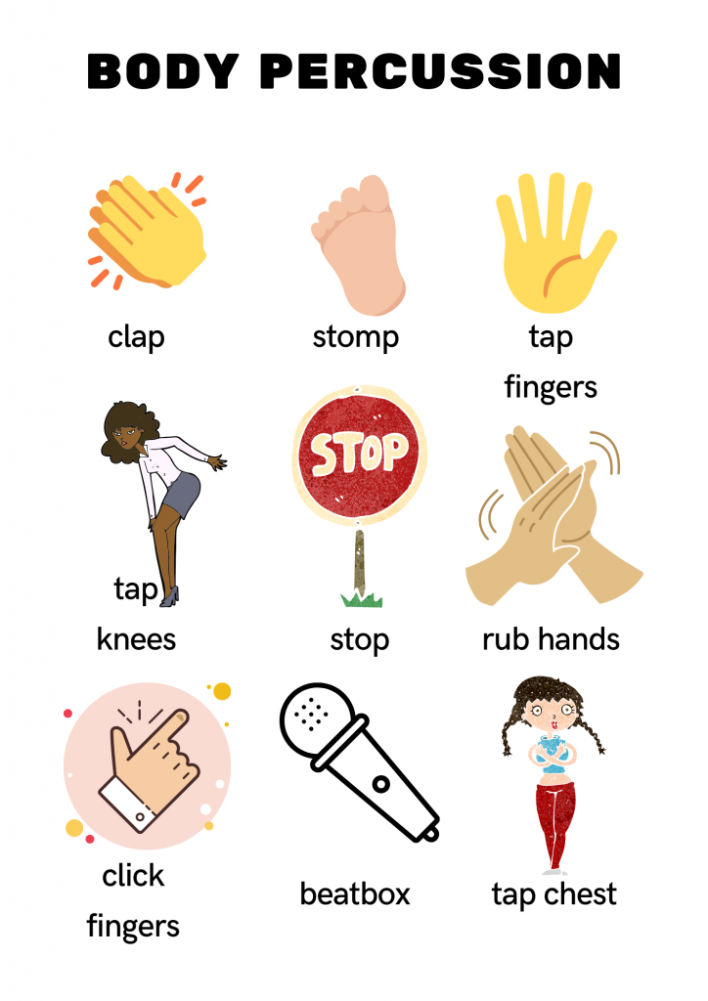
Final Task
For example:
 | 1 | + | 2 | + | 3 | + | 4 | +
ACHIEVED

Slide 12
Final Task
You will need to make sure you leave the correct amount of spaces after each note!
Quavers = no spaces
Crotchet = one space
Minim = three spaces
ACHIEVED

Slide 13
Today we learned
We learned about notation and their values.
How to write rhythms with notation.
We learned how to correctly read notation.
ACHIEVED

Slide 14
Well Done Today!
Now it’s time for…

Slide 15

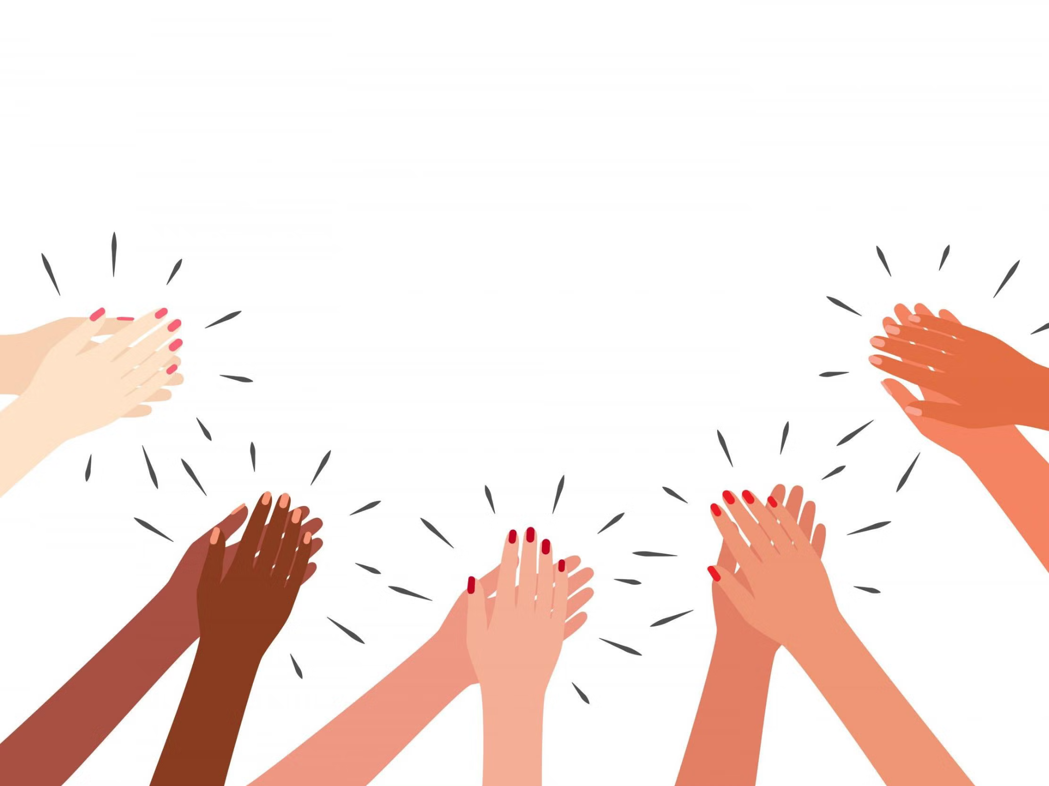
DON’T CLAP BACK
Notes:
Don’t clap back is a listening game. similar to ‘Simon Says’
The leader will clap patterns and the class is to repeat those rhythms back to the leader.
there are a few rhythms that the class SHOULD NOT clap back, the first one is:
dont. clap. this one back. - - … (long, long, short short short.)
anyone who claps this pattern is out of the game and needs to sit down.
the winner is the last one standing.
as the game goes on speed up the patterns or you can try and trick the students.
there additional rhythms you can add to make the game harder.
dont clap back - - - (long long long)
and
Dont clap this back - - - - (long long long long)
both of these patterns can be clapped at any speed which makes them more difficult to recognise.

