Slide 1


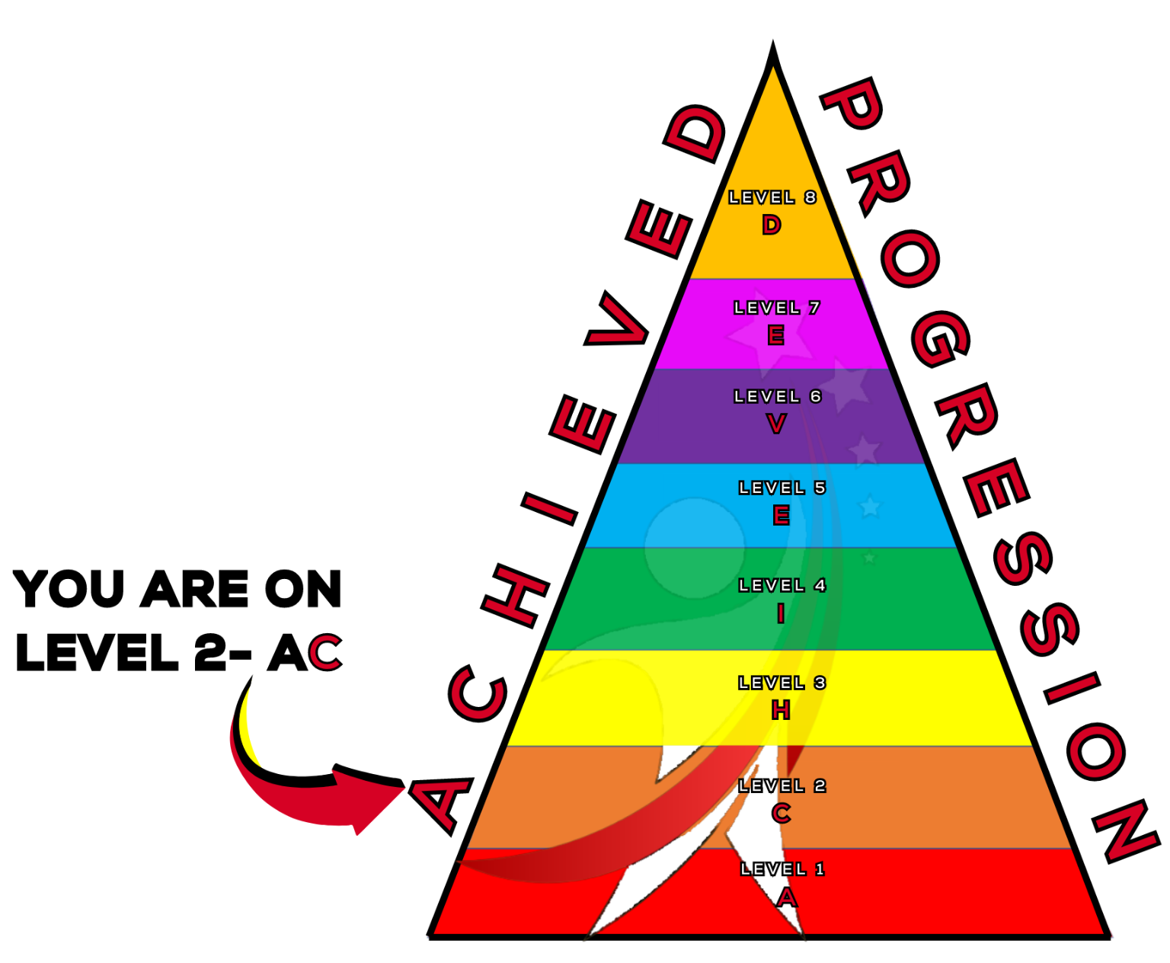
Understanding Tempo
A topic from Thespian Progression Level 2 - C

Slide 2
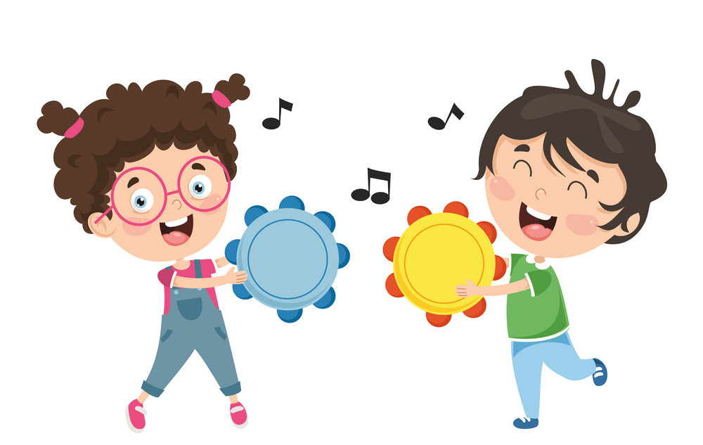

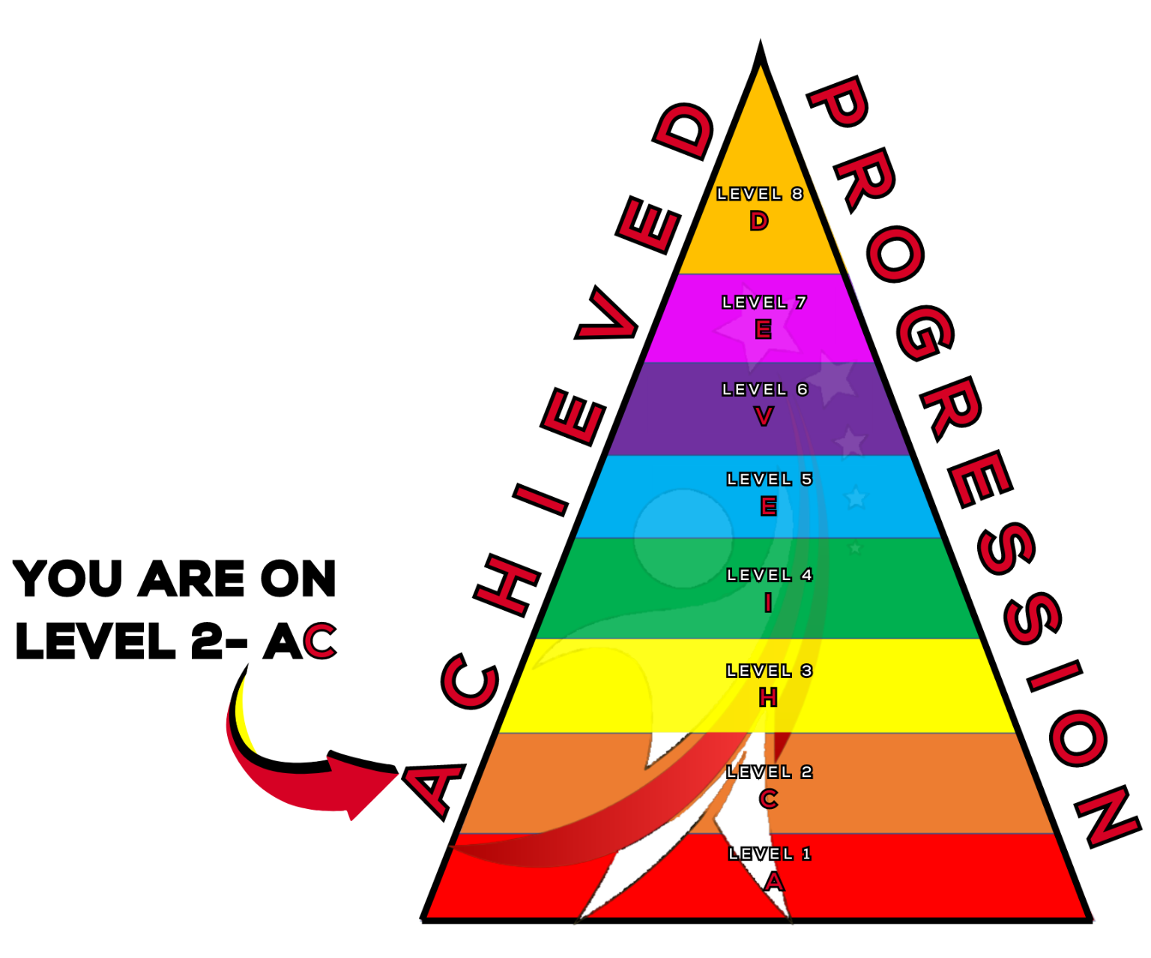

What will we learn today?
We will develop our understanding of tempo.
We will be able to recognise different tempos in songs.
ACHIEVED

Slide 3
Quick Recap!
What is
rhythm and pulse?
Who can tell me what tempo is?

Slide 4
Rhythm, pulse and tempo
A pulse is a beat that is regular. A rhythm is a pattern of sounds of different lengths!
Tempo is how fast or slow a pulse is.
ACHIEVED

Slide 5
Tempo
Tempo is how fast or slow a beat is. Tempo is measured in beats per minute or BPM for short. BPM is how many beats fit within a minute.
60 BPM means that there is one beat every second. This is because there are 60 seconds in a minute.
120 bpm means there are 2 beats per second!
ACHIEVED

Slide 6
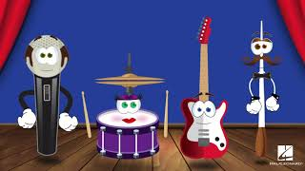
The Music Show - Tempo
ACHIEVED

Slide 7
Tempo
In that video you heard 3 words. Presto: which means fast. Largo: which means slowly. What was the last one?
Moderato! Which means moderately or medium.
Presto, moderato and largo are all italian words, this is because modern music notation was invented by an italian monk, Guido D’Arrezzo, over 800 years ago!
ACHIEVED

Slide 8
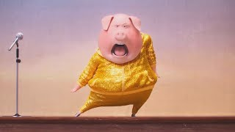
Clap along with the pulse of the songs!
ACHIEVED

Slide 9
You may have noticed
You may have noticed that the songs in that video changed in tempo quite a lot.
A songs tempo can drastically change how a song feels. Fast tempos may make the song sound happier, energetic or exciting.
How might a slow tempo song make you feel?
ACHIEVED

Slide 10
Final Task
Fill in the blanks!
_____ is a pattern of sounds of different lengths.
_____ is a beat that is regular.
_____ is how fast or slow a piece of music is.
The italian word for a fast tempo is _____.
The italian word for a slow tempo is _____.
The Italian word for a medium tempo is _____.
Tempo can change how a song _____ to the listener.
ACHIEVED

Slide 11
Today we learned
What tempo is and how it affects songs.
We learned how to identify fast and slow tempos.
We learned the italian words to describe tempos.
ACHIEVED

Slide 12
Well Done Today!
Now it’s time for…

Slide 13


DON’T CLAP BACK
Notes:
Don’t clap back is a listening game. similar to ‘Simon Says’
The leader will clap patterns and the class is to repeat those rhythms back to the leader.
there are a few rhythms that the class SHOULD NOT clap back, the first one is:
dont. clap. this one back. - - … (long, long, short short short.)
anyone who claps this pattern is out of the game and needs to sit down.
the winner is the last one standing.
as the game goes on speed up the patterns or you can try and trick the students.
there additional rhythms you can add to make the game harder.
dont clap back - - - (long long long)
and
Dont clap this back - - - - (long long long long)
both of these patterns can be clapped at any speed which makes them more difficult to recognise.

