Slide 1


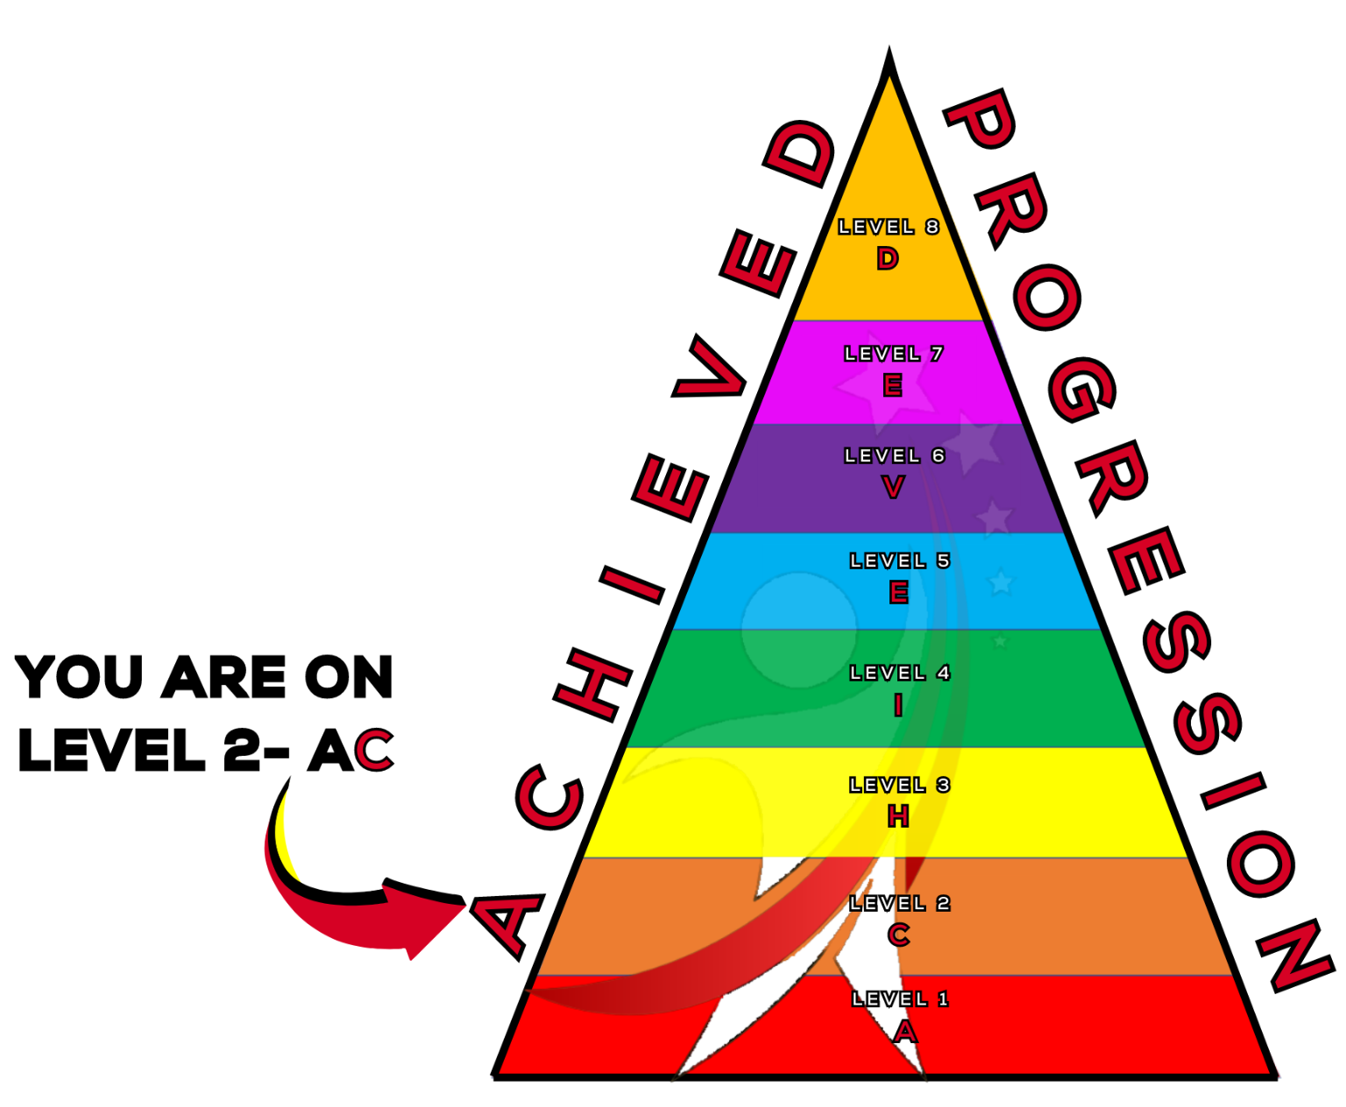
Applying Notation
A topic from Thespian Progression Level 2 - C

Slide 2
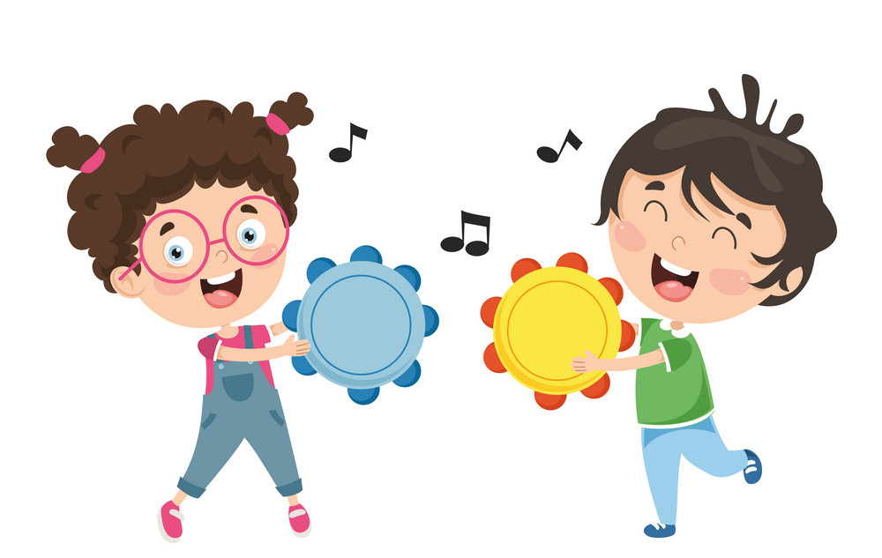

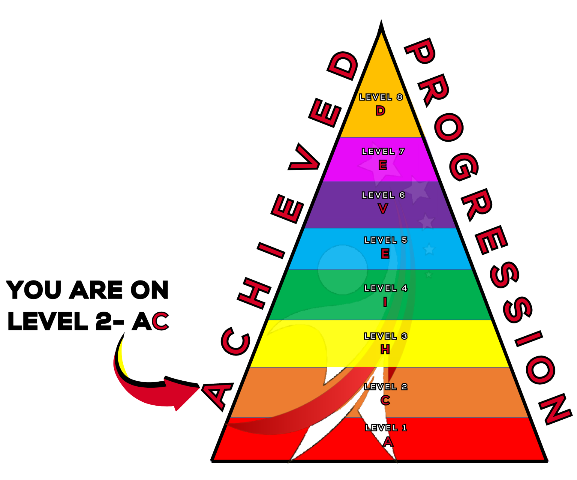

What will we learn today?
How to write notation for the songs we created last week.
Accompany the songs with percussion elements.
ACHIEVED

Slide 3




Who remembers…
Quaver
½ beat
Crotchet
1 beat
Minim
2 beats
Semibreve
4 beats
Longer in duration
ACHIEVED
Notes:
A quaver (like the crisp) last for half a beat.
A crotchet lasts for 1 beat.
A minim lasts for 2 beats.
A semibreve lasts for 4 beats.
Each note DOUBLES in value.
you can fit 2 quavers in 1 crotchet. 2 crotchets in 1 minim. 2 minims in 1 semibreve.

Slide 4
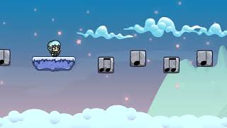


Ta and Ti-Ti
Say
Ti-Ti!
Say
Ta!
ACHIEVED

Slide 5
Last week we created a song
In your groups you:
Decided what your song is about.
Started the song by singing on the pulse.
Then change into a rhythm, using ‘ta and titi’ to help.
Lastly, you created a call and response lyrics for your song.
ACHIEVED

Slide 6
Get into your groups!
Let’s get
our songs ready!

Slide 7
Adding notation to our song
On your song sheet you are going to write the lyrics to your song. Above the lyrics you are going to write the notation.
Your first verse should have followed the pulse of the song, so all the notes should be crotchets. Have a practice at drawing them!
ACHIEVED

Slide 8
Following the pulse
The sheet for your first verse should look like this. Your lyrics should follow the pulse so each word should last one beat.
I | like | french | fries
ACHIEVED

Slide 9
Now try your second and third verse
You will now need to draw quavers. Clap the rhythm of your lyrics to help work out where the crotchets and quavers go! For example:
I | like | cheesy | pizza
Two syllable words will usually be quavers!
ACHIEVED

Slide 10
Now the lyrics of your songs are mapped out
Let’s have a go at adding some percussion instruments to the song!
Each of you will need to create your own rhythms, you will need to repeat this pattern all the way through your song, mark them out in the top section of your rhythm sheet.
For each verse someone will need to keep a steady pulse, decide who will keep the pulse first, second then third.
ACHIEVED

Slide 11
Get ready!
We will go around
the room and listen
to your songs!
Don’t forget to join in on
the call and response verse!

Slide 12
Today we learned
How to recognise rhythms and write notation for the rhythms.
Create and perform rhythms on percussion instruments to accompany the song.
ACHIEVED

Slide 13
Well Done Today!
Now it’s time for…

Slide 14


DON’T CLAP BACK
Notes:
Don’t clap back is a listening game. similar to ‘Simon Says’
The leader will clap patterns and the class is to repeat those rhythms back to the leader.
there are a few rhythms that the class SHOULD NOT clap back, the first one is:
dont. clap. this one back. - - … (long, long, short short short.)
anyone who claps this pattern is out of the game and needs to sit down.
the winner is the last one standing.
as the game goes on speed up the patterns or you can try and trick the students.
there additional rhythms you can add to make the game harder.
dont clap back - - - (long long long)
and
Dont clap this back - - - - (long long long long)
both of these patterns can be clapped at any speed which makes them more difficult to recognise.

