Slide 1


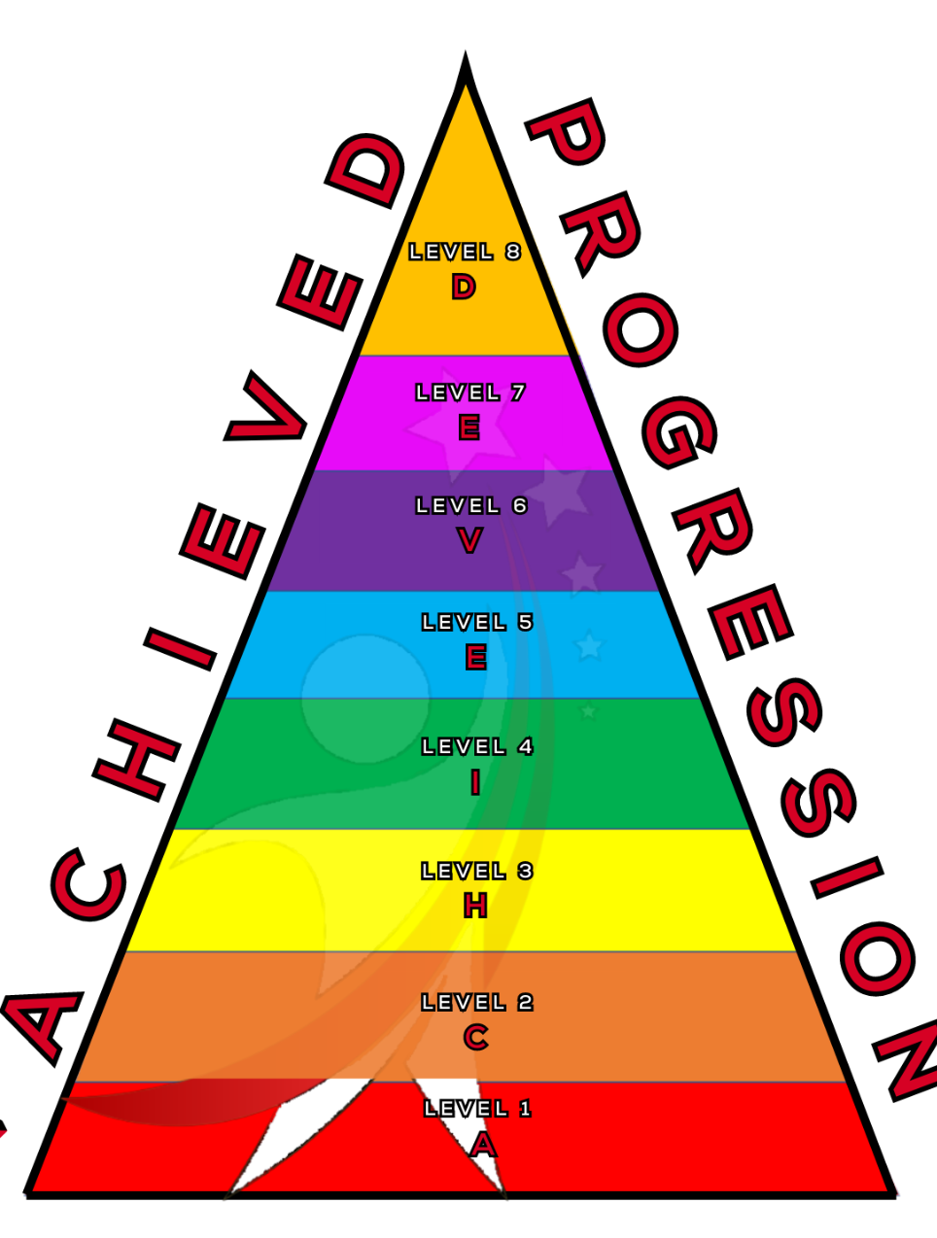
Notation and Rhythm
Understanding how we can use notation to show rhythm used in music
Notes:
In todays lesson we will be learning about Notation and Rhythm

Slide 2



What will we learn today?
You will be able to:
Understand how Notation shows Rhythm.
Use notation to perform Body percussion.
Use notation to perform using Instruments.
ACHIEVED
Notes:
Explain to the children what we will be doing today

Slide 3

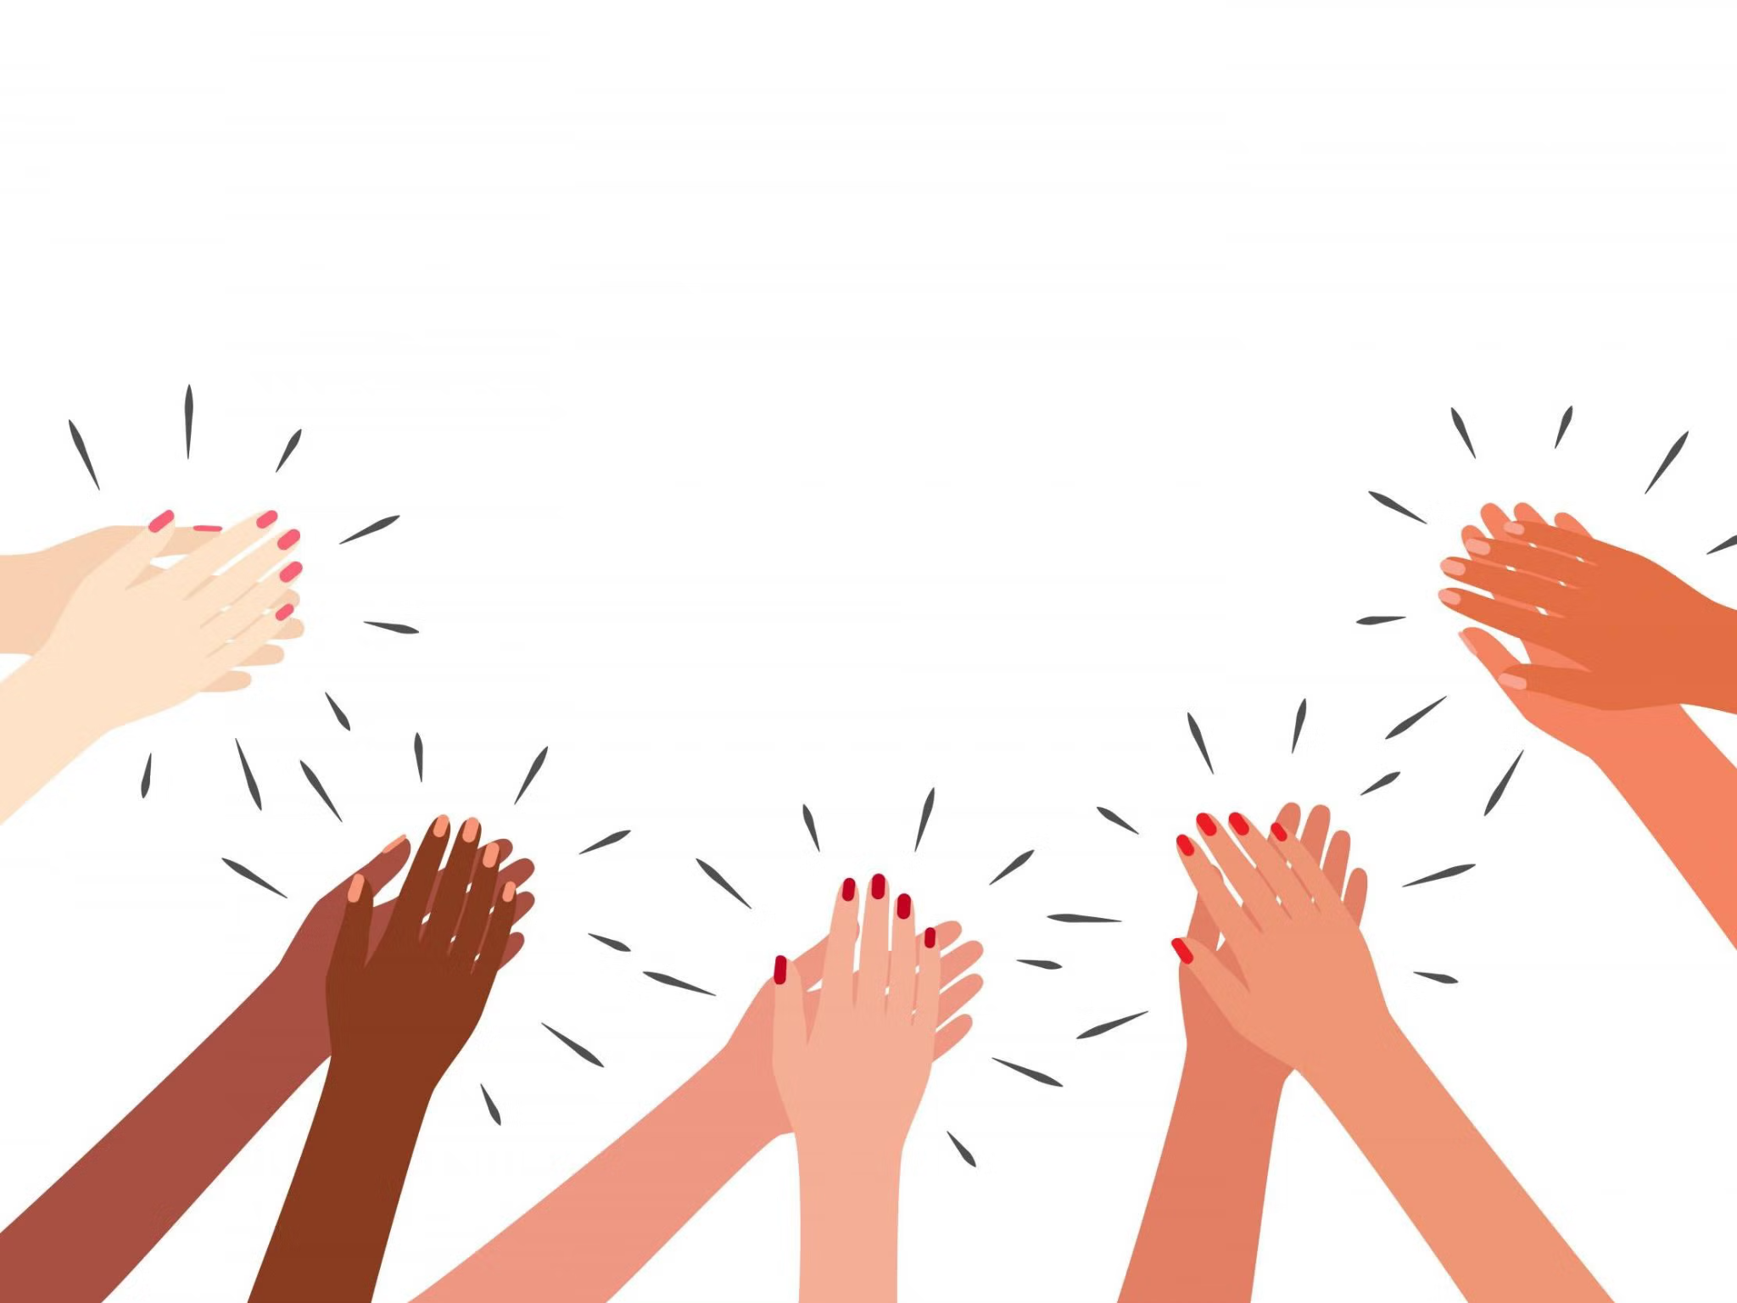
DON’T CLAP BACK
Notes:
Don’t clap back is a listening game. similar to ‘Simon Says’
The leader will clap patterns and the class is to repeat those rhythms back to the leader.
there are a few rhythms that the class SHOULD NOT clap back, the first one is:
dont. clap. this one back. - - … (long, long, short short short.)
anyone who claps this pattern is out of the game and needs to sit down.
the winner is the last one standing.
as the game goes on speed up the patterns or you can try and trick the students.
there additional rhythms you can add to make the game harder.
dont clap back - - - (long long long)
and
Dont clap this back - - - - (long long long long)
both of these patterns can be clapped at any speed which makes them more difficult to recognise.

Slide 4

Who remember what these are?
Crotchet
1 Beat
Minim
2 Beats
Semibreve
4 Beats
Quaver
Half a Beat
ACHIEVED
Notes:
Ask the class if they can know the names of each of the musical notes in order.
ANSWER- crotchet, minim, semibreve, quaver.
Then ask the class if they know the values of each note?
What is the value of a crotchet? ANSWER- 1 beat
What is the value of a minim? ANSWER- 2 beats
What is the value of a semibreve? ANSWER- 4 beats
What is the value of a quaver? ANSWER- half a beat!
How many quavers can fit in 1 beat?
ANSWER- Two! because 2 halves= 1

Slide 5
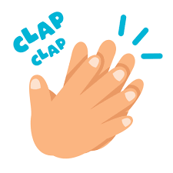

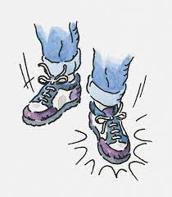

What are these?
Does this look Familiar?
 | 1 | 2 | 3 | 4 | 1 | 2 | 3 | 4
Have a go!
ACHIEVED
Notes:
do these look familiar?
What is the name of the notes that we will be clapping? ANSWER- Crotchet.
What is the name of the note that we will be stomping? ANSWER- semibreve.
Encourage the class to to perform this song, split the class in half and get them to play both patterns.

Slide 6
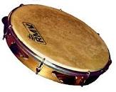
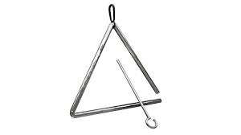
We can change out the instruments we use!
 | 1 | 2 | 3 | 4 | 1 | 2 | 3 | 4
ACHIEVED
Notes:
Use the tambourines and triangles to perform the same song.
ensure pupils are playing the instruments correctly.
tambourines will play on every number
triangles will play on every beat 1

Slide 7
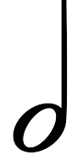
Does it sound different if we change the notes?
 | 1 | 2 | 3 | 4 | 1 | 2 | 3 | 4
ACHIEVED
Notes:
Now what have the notes changed to? ANSWER- minims.
now the triangle players will need to play every two beats! every time the teacher says 1 and 3.
lets have a go at the new pattern as a whole class!

Slide 8

Your turn with your partners create a song!
 | 1 | 2 | 3 | 4 | 1 | 2 | 3 | 4
1 Beat
2 Beats
4 Beats
Half a beat
Be careful with this one! Why?
ACHIEVED
Notes:
WORKSHEET
each student will need to be in groups of 2-4. using the notes on the board, you will create a song on your percussion instruments.
why do we need to be careful with quavers? ANSWER- because you need to play it twice in one beat.
the pupils will need to count out loud together and play the notes they have written for each of their instruments.

Slide 9
What we have learned today
Understood how Notation shows Rhythm.
Able to use notation to perform Body percussion.
Able to use notation to perform using Instruments.
Created your own song in groups of 2-4.
ACHIEVED
Notes:
you have now learned how notation forms rhythms, creating a pattern of sounds of different lengths.
you have used notation to perform songs on body percussion and percussion instruments
and you have created you own songs!
IF THERE IS ENOUGH TIME
give the students an opportunity to perform their songs in front of the class.

