Slide 1


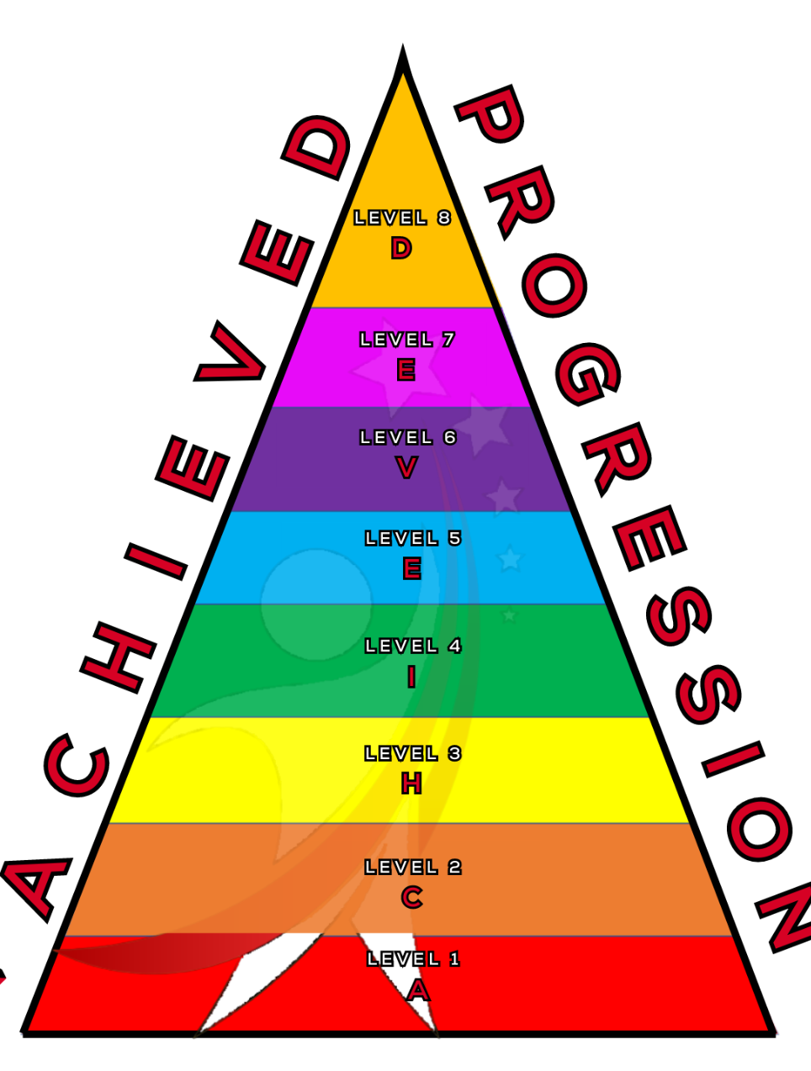
Dynamics
Understanding what dynamics are and how to use them effectively
Notes:
Today we will be Continuing with dynamics

Slide 2



What will we learn today?
You will be able to:
Understand what dynamics are.
How to identify them in music.
Know the Italian language of dynamics.
ACHIEVED
Notes:
Explain to the children what we will be doing today

Slide 3


DON’T CLAP BACK
Notes:
Don’t clap back is a listening game. similar to ‘Simon Says’
The leader will clap patterns and the class is to repeat those rhythms back to the leader.
there are a few rhythms that the class SHOULD NOT clap back, the first one is:
dont. clap. this one back. - - … (long, long, short short short.)
anyone who claps this pattern is out of the game and needs to sit down.
the winner is the last one standing.
as the game goes on speed up the patterns or you can try and trick the students.
there additional rhythms you can add to make the game harder.
dont clap back - - - (long long long)
and
Dont clap this back - - - - (long long long long)
both of these patterns can be clapped at any speed which makes them more difficult to recognise.

Slide 4
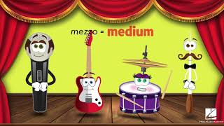
Let’s sing along!
ACHIEVED

Slide 5
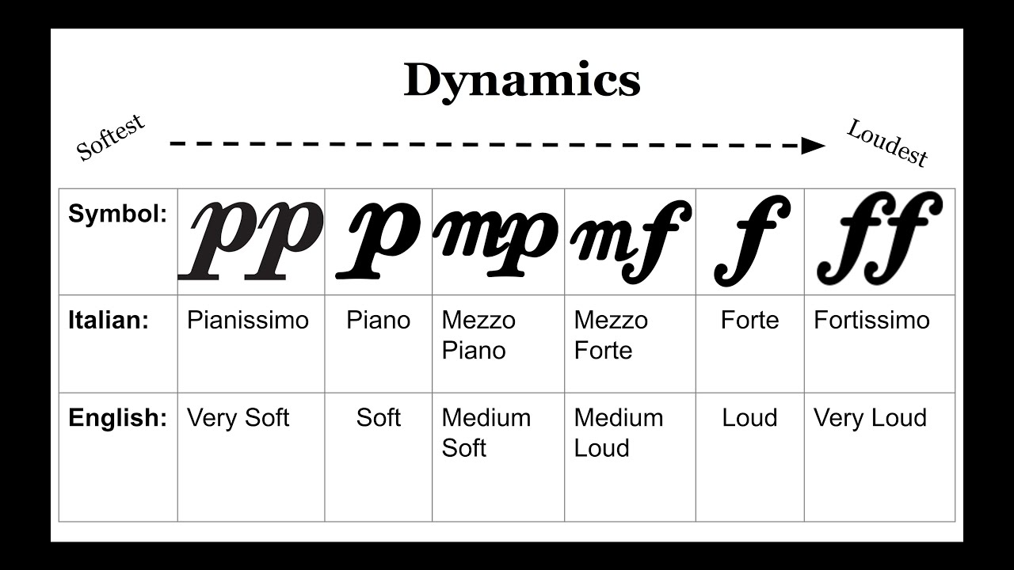
Dynamics are the different levels of volume we use in music!
What are the italian words for these symbols?
What do they mean?
ACHIEVED
Notes:
P represents piano which means softly or quietly
MP represents Mezzo Piano which means medium soft or quiet
MF represents Mezzo Forte which means medium loud
F represents Forte which means loud.

Slide 6
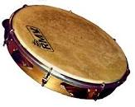
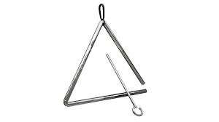
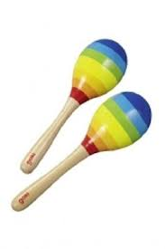
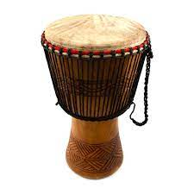
Can we try this together with our instruments!
ACHIEVED
Notes:
Encourage students to play their percussion instruments using different dynamics.
Make sure for ‘piano’ it is very quiet, get the students to play as quiet as possible.

Slide 7



Can we add some dynamics to our songs!
 | 1 | 2 | 3 | 4
 | Your | song | is | here
Notes:
WORKSHEET
Encourage Students to use varying dynamics for each instrument and each line of their song. even better if they are able to use the dynamics to relate to a lyric in the song.

Slide 8
What we have learned today
Understood what dynamics are.
How to identify them in sheet music.
Know the Italian language of dynamics.
Made our own songs with dynamics.
ACHIEVED

