Slide 1


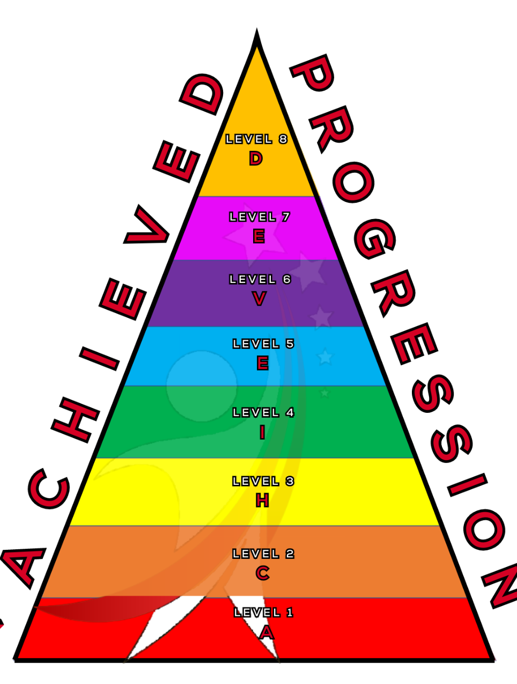
Dynamics
Understanding what dynamics are and how to use them effectively
Notes:
In todays lesson we will continue learning about dynamics.

Slide 2



What will we learn today?
You will be able to:
Understand what dynamics are.
How to identify them in music.
Know the Italian language of dynamics.
ACHIEVED
Notes:
Explain to the children what we will be doing today

Slide 3


DON’T CLAP BACK
Notes:
Don’t clap back is a listening game. similar to ‘Simon Says’
The leader will clap patterns and the class is to repeat those rhythms back to the leader.
there are a few rhythms that the class SHOULD NOT clap back, the first one is:
dont. clap. this one back. - - … (long, long, short short short.)
anyone who claps this pattern is out of the game and needs to sit down.
the winner is the last one standing.
as the game goes on speed up the patterns or you can try and trick the students.
there additional rhythms you can add to make the game harder.
dont clap back - - - (long long long)
and
Dont clap this back - - - - (long long long long)
both of these patterns can be clapped at any speed which makes them more difficult to recognise.

Slide 4
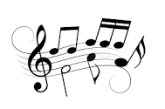
What are dynamics?
Dynamics are the volume level in music.
They can be LOUD, soft and everything in between!
Musicians use a variety of dynamics to add excitement and emotion to songs.
ACHIEVED
Notes:
Dynamics are the volume level in music.
They can be loud, soft and everything inbetween
Musicians use dynamics to add excitement and emotion to songs.
What feeling might i be feeling if i was singing quietly? ANSWER- sad, tired, secretive, relaxed etc.
how about if i was singing loudly? ANSWER- Excited, happy, angry etc.

Slide 5
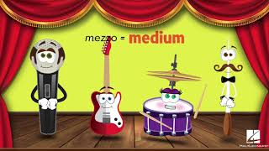
ACHIEVED

Slide 6

What Italian music words did we hear?
Talk with your partners!
Hands up, what words did we hear?
Forte = Loud
Piano = Soft
Mezzo = Medium
ACHIEVED
Notes:
In your pairs what were the italian words for dynamics?
ANSWERS-
forte- loud
Piano- soft
Mezzo- Medium

Slide 7
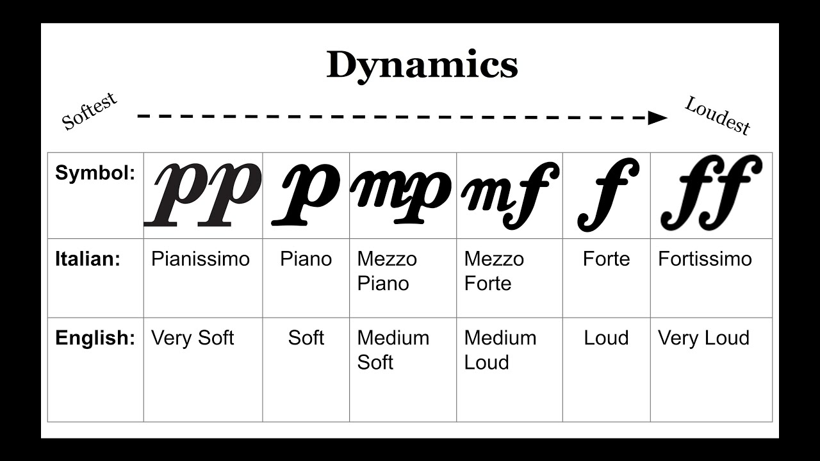
This is what Dynamics will look like on sheet music!
Remember Mezzo means Medium, so Mezzo Piano is Medium soft
So what does Mezzo Forte mean?
ACHIEVED
Notes:
We need to remember the symbols to represent dynamics.
P represents piano which means softly or quietly
MP represents Mezzo Piano which means medium soft or quiet
MF represents Mezzo Forte which means medium loud
F represents Forte which means loud.

Slide 8
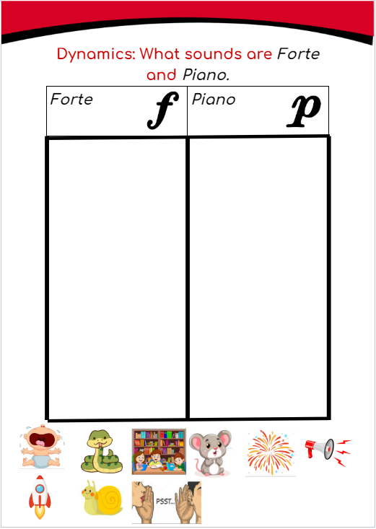
Let’s do a worksheet! Match the sounds to the dynamic!
ACHIEVED
Notes:
WORKSHEET
Cut out the images below and stick them under the corresponding boxes. Or write the words for each image.
Crying
Snake
Library
Mouse
Firework
Speaker
Rocket
Snail
Whisper

Slide 9
Let’s sing along this time!
ACHIEVED

Slide 10
What we have learned today
Understood what dynamics are.
How to identify them in sheet music.
Know the Italian language of dynamics.
ACHIEVED
Notes:
Recap with the students what they have learned in todays lesson.

